Slide 1
Harris Corner detection

Slide 2
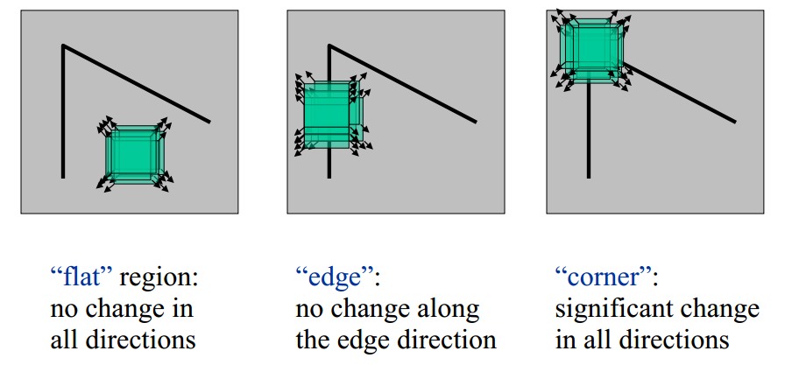
목적 / idea
https://dsp.stackexchange.com/questions/14338/corner-detection-using-chris-harris-mike-stephens
Corner를 찾고 싶음
Patch를 움직이면 Intensity 변화가 모든 방향으로 생길 때 !

Slide 3

구현
E is the difference between the original and the moved window.
u is the window's displacement in the x direction
v is the window's displacement in the y direction
w(x, y) is the window at position (x, y). This acts like a mask. Ensuring that only the desired window is used.
I is the intensity of the image at a position (x, y)
I(x+u, y+v) is the intensity of the moved window
I(x, y) is the intensity of the original

Slide 4




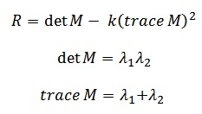

간략화?

Slide 5
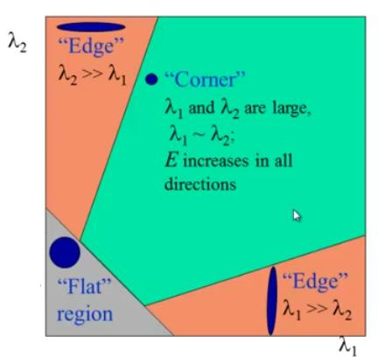

Slide 6
score

